Slide 1
Is fast food really unhealthy?
Dongrun Jia, Hao Liu, Xueyan Liu

Slide 2
Introduction
Global fast food industry is worth $570 Billion
In the United States, 36.6% of adults consumed fast food on a given day.
Audience:
People who cares about health
Approach :
Analyzing the food composition
Looking for the correlation between fast food prevalence and health index at state level.
Application : recommendation system

Slide 3
Datasets:
Four different datasets were used in our project:
Obesity dataset (state level)
Diabetes dataset (state level)
Restaurant dataset (city level)
All-items dataset (Append 16 restaurants’ menu)

Slide 4
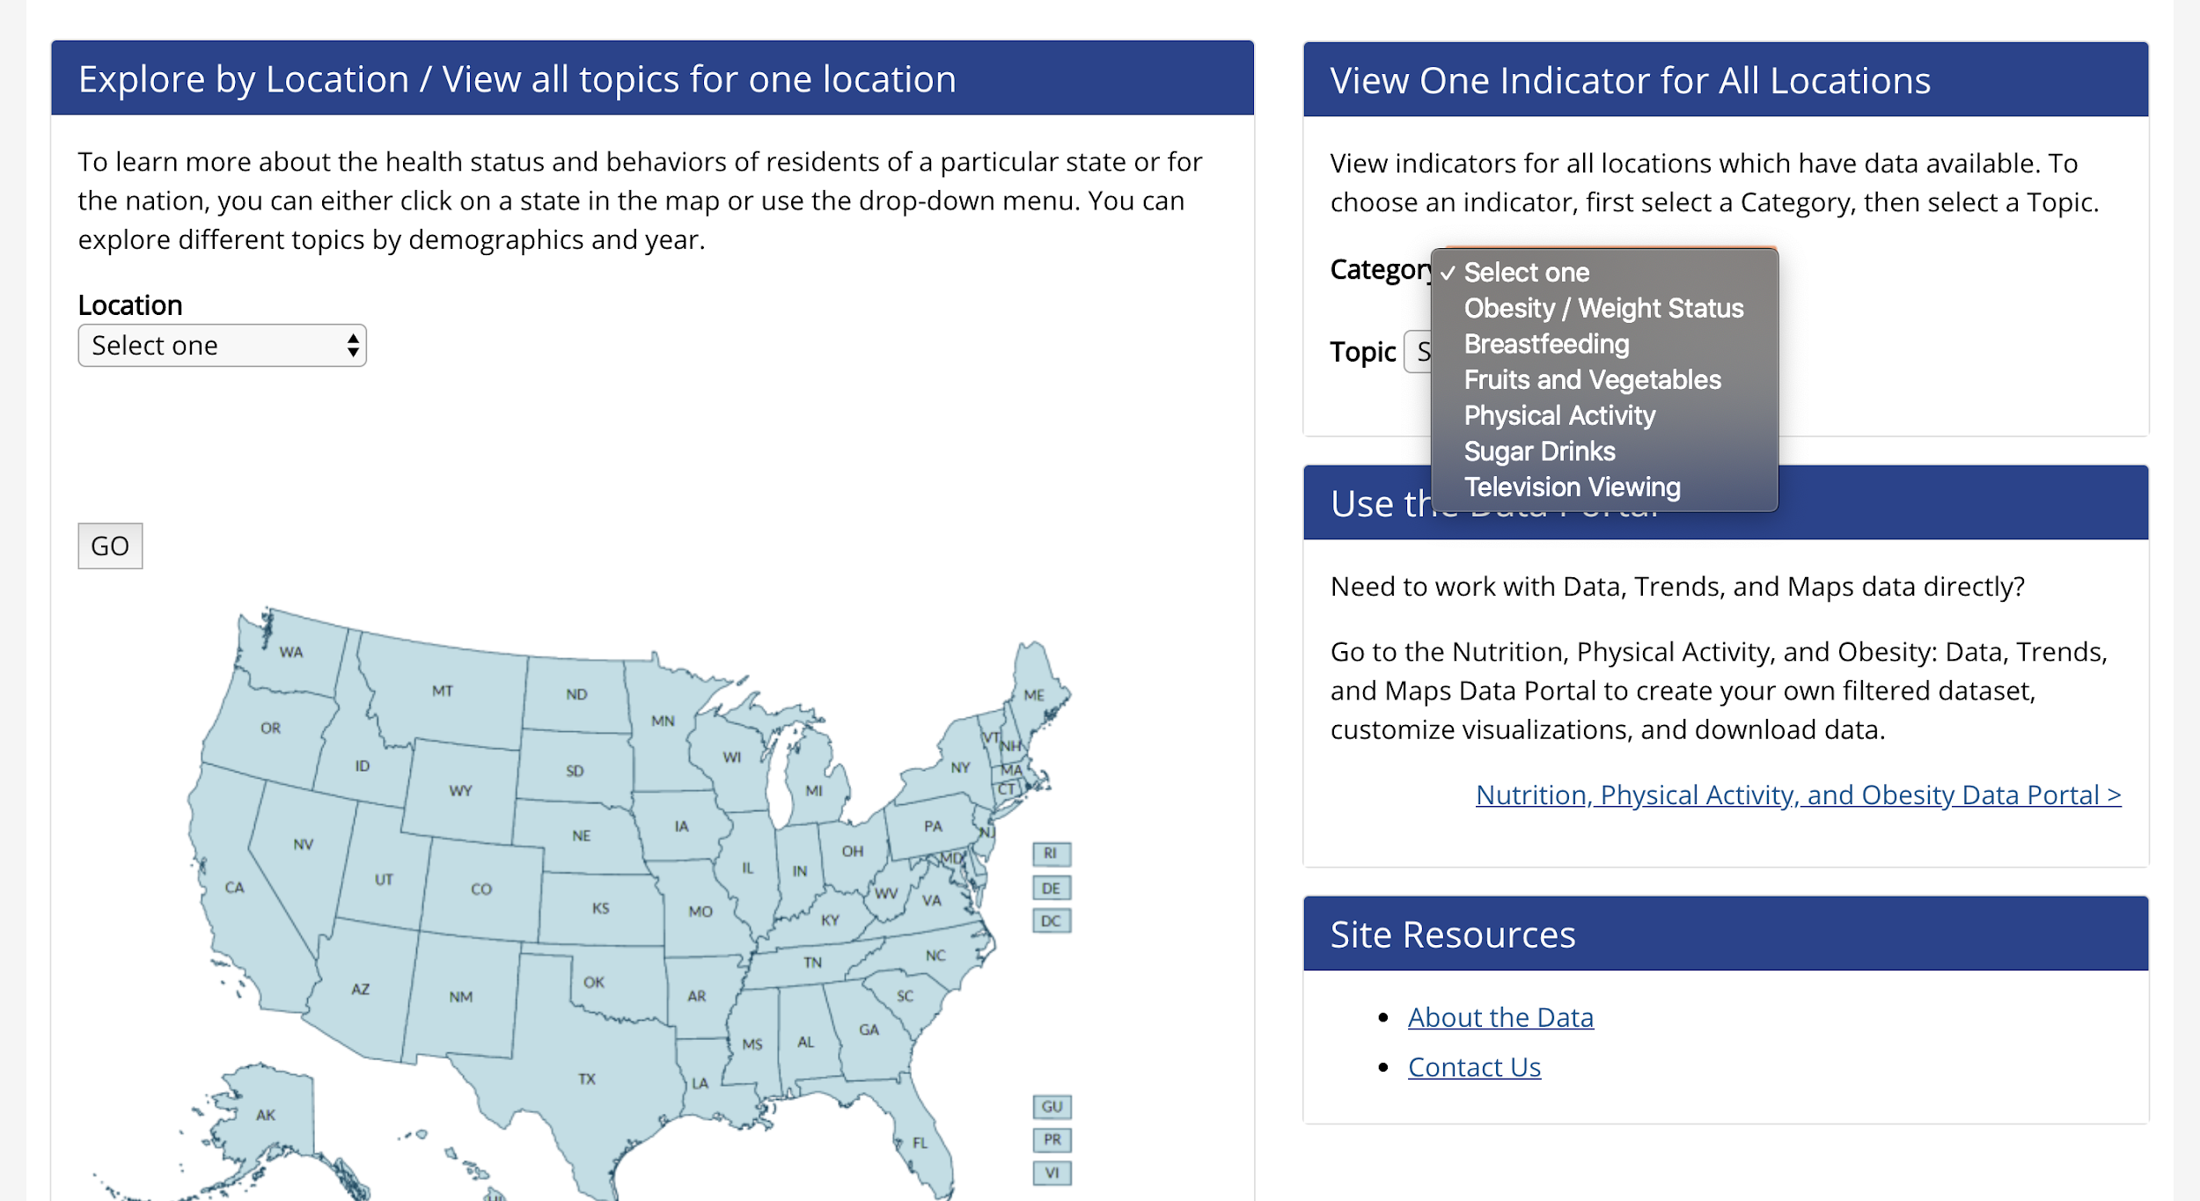
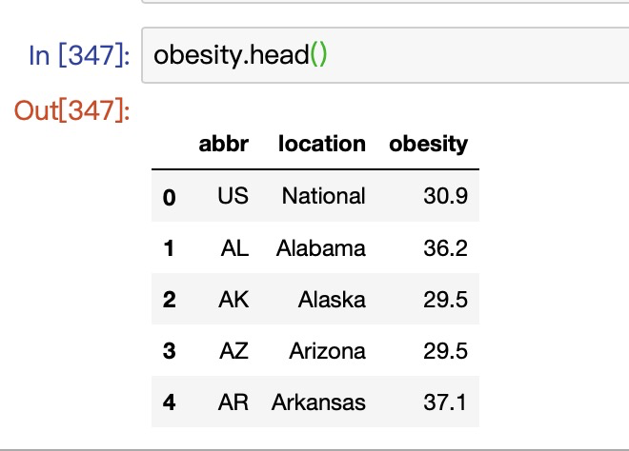
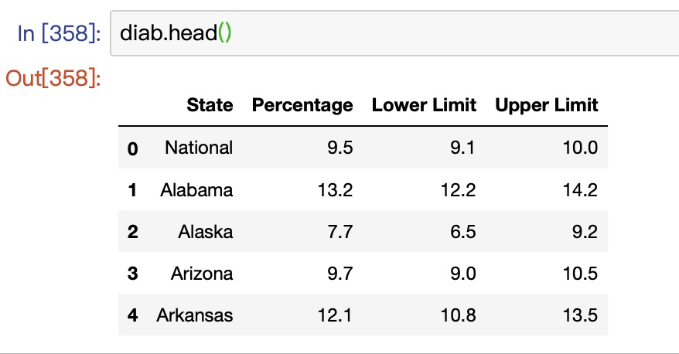
Dataset details
Obesity and Diabetes datasets
Retrieve from CDC (Centers for Disease control and prevention)

Slide 5
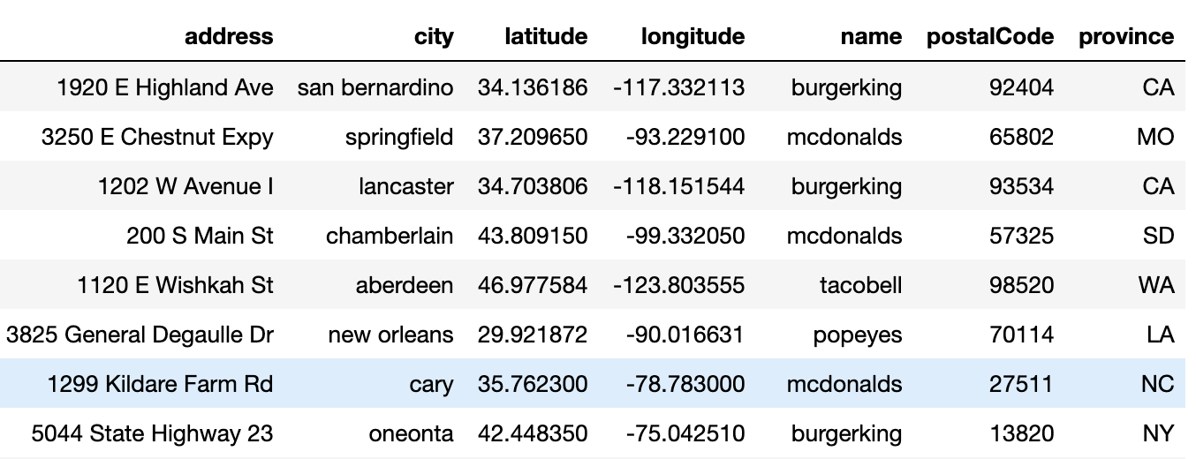
Dataset details
Fast food restaurant dataset
Retrieve from Kaggle https://www.kaggle.com/datafiniti/fast-food-restaurants
Notes:
There are over 10k restaurants in the dataeset, We selected 16 leading fast food chain to represent the whole dataset

Slide 6
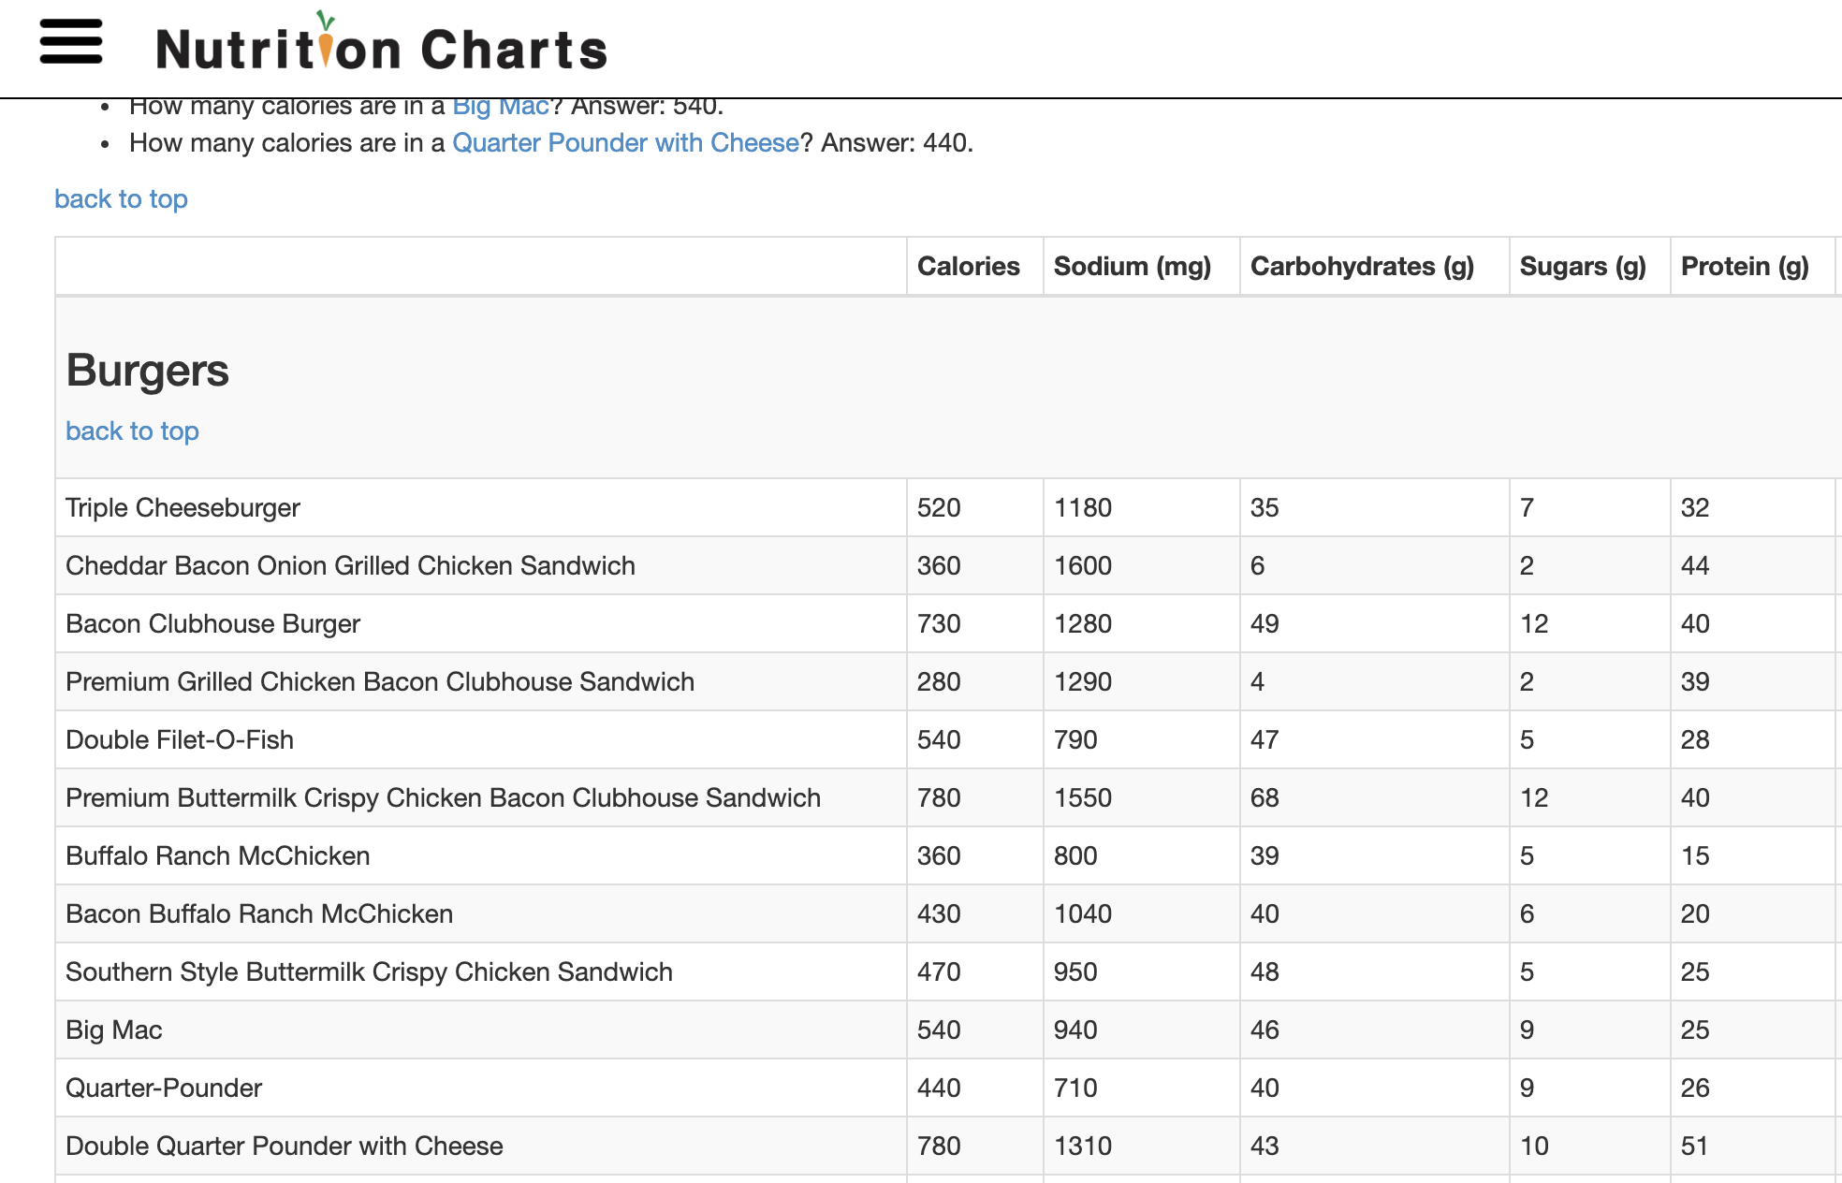
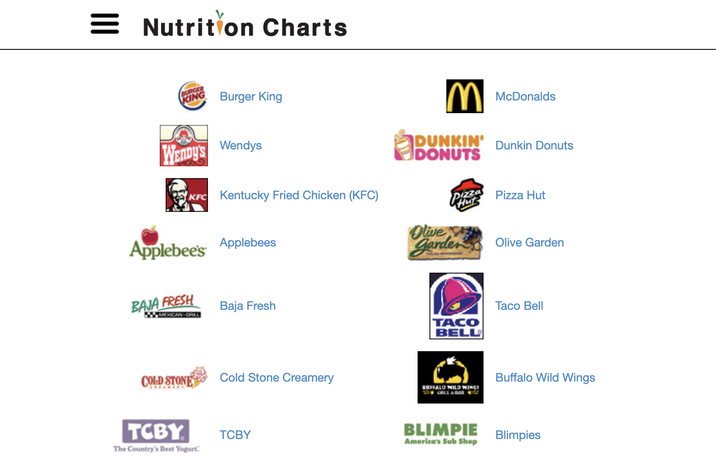
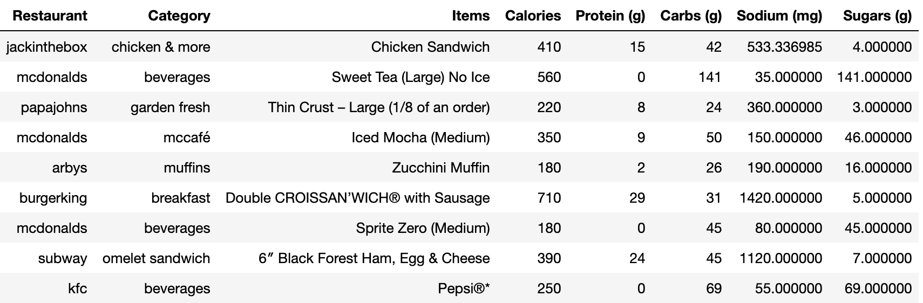
Dataset details
All items dataset
Retrieve from Nutrition Charts, https://www.nutrition-charts.com/

Slide 7
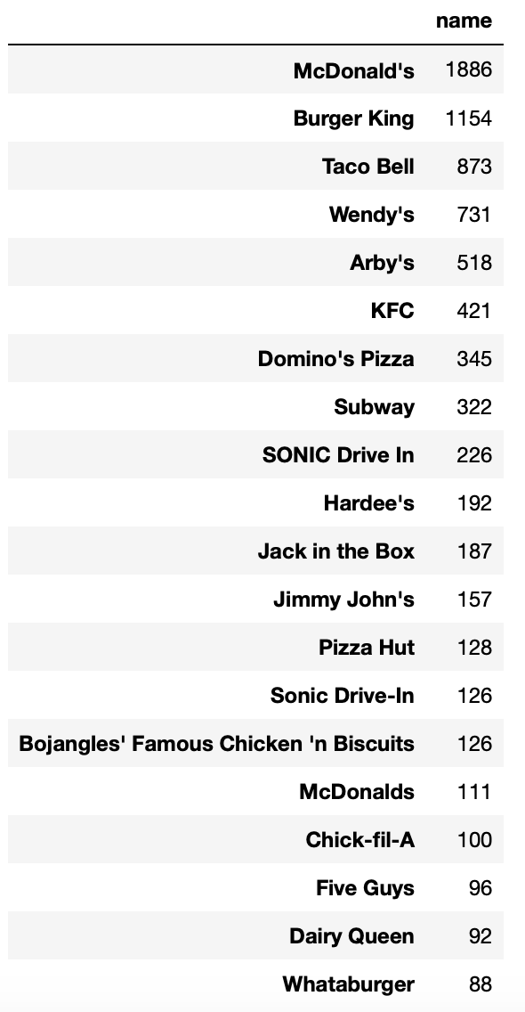
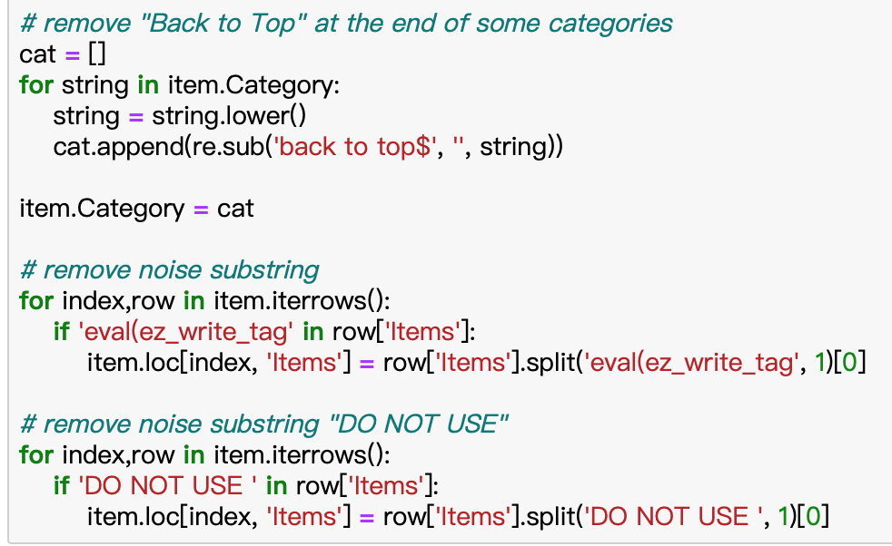
Data cleaning
Unify restaurants’ name (lowercase, remove special characters)
Remove noisy substring generated from web scraping
Adjust columns order
Filter out sauces and kid’s menu
Reduce unnecessary columns

Slide 8
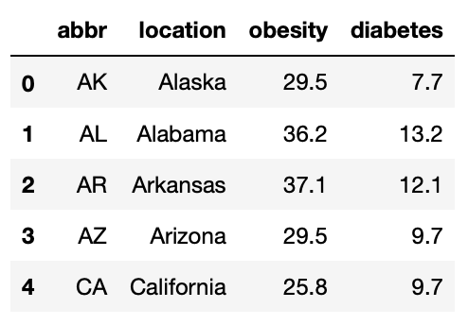
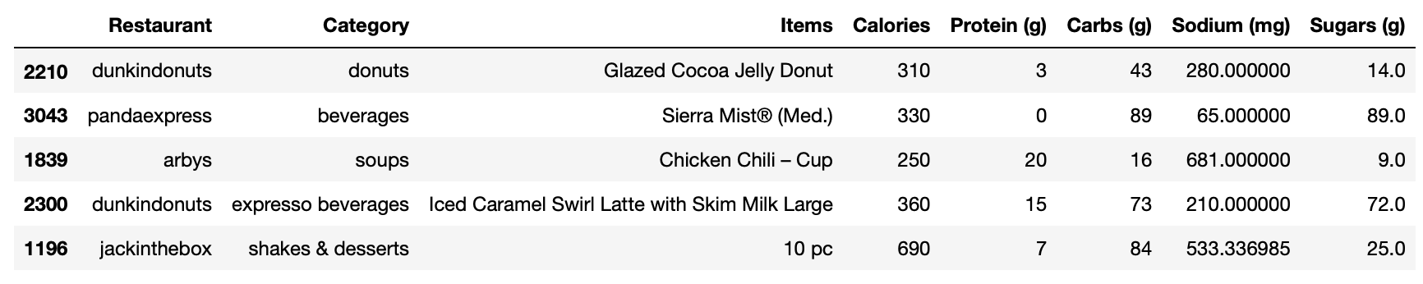
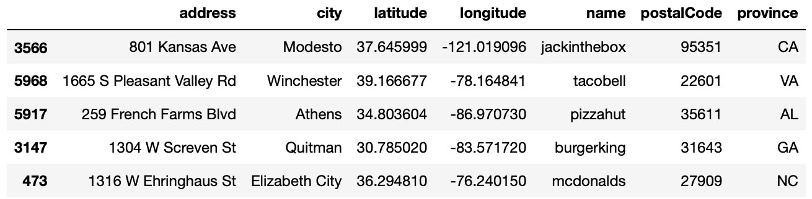
Cleaned dataset
Item.csv
State_health.csv
Restaurants.csv

Slide 9
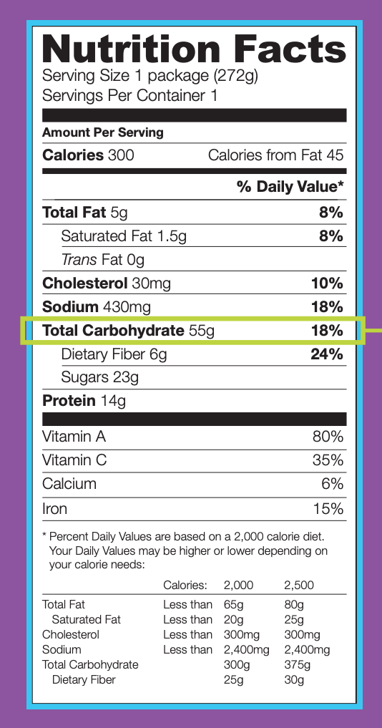
Analyze the Food Composition
Analyze the food composition
Calories
Protein
Carbohydrate
Sugar
Sodium
Reference Data
Dietary Guidelines - Office of Disease Prevention and Health Promotion (ODPHP)
Nutrition Fact Label - FDA

Slide 10
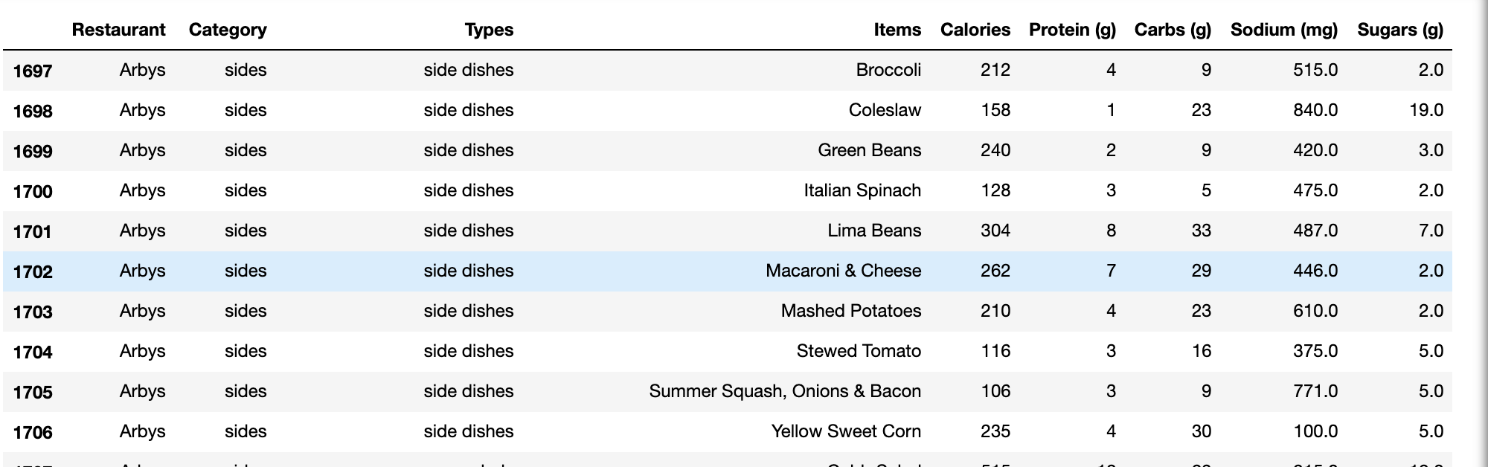
Fast Food Nutrition Fact Data
Fast Food Data
Choose the 16 most popular fast-food restaurants in USA
Scrape their menus and nutrition fact from the website.
Divide their menus into 3 parts: Entrees, Sides or Salads, Beverages

Slide 11
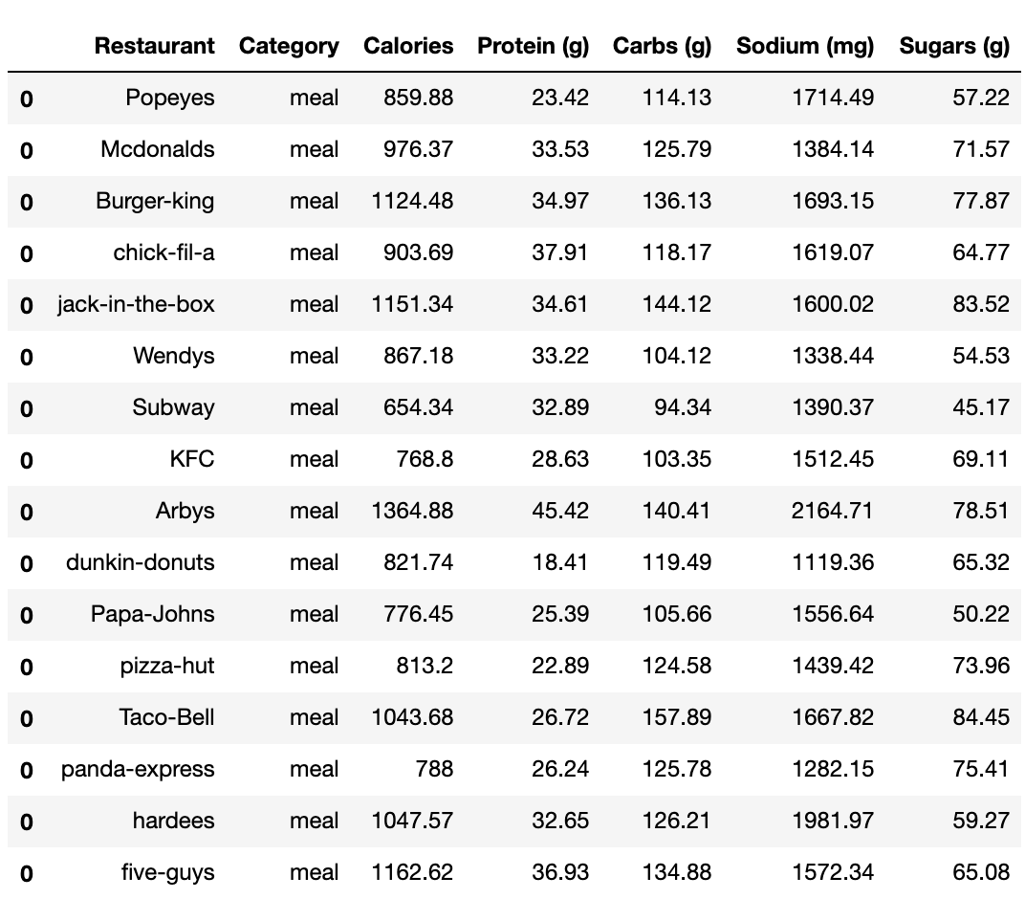
Fast Food Nutrition Fact Data
One meal = Entrees + Sides + Beverages
Calculate the average nutrition fact content per meal

Slide 12
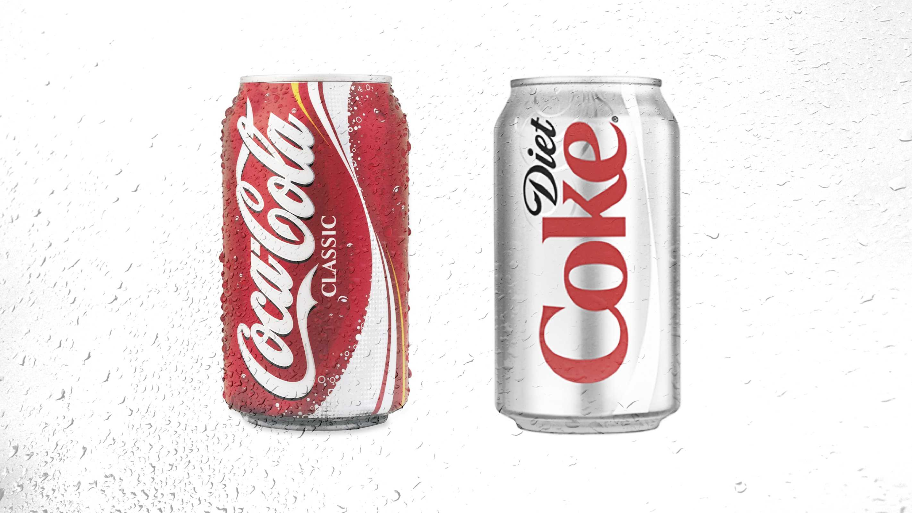
Calories
Calories in food provide energy in the form of heat so that our bodies can function.
Recommended calorie intake depends on factors such as age, size, height, sex, lifestyle, and overall general health.
In our case, we will use 2000 Calories as criteria.

Slide 13
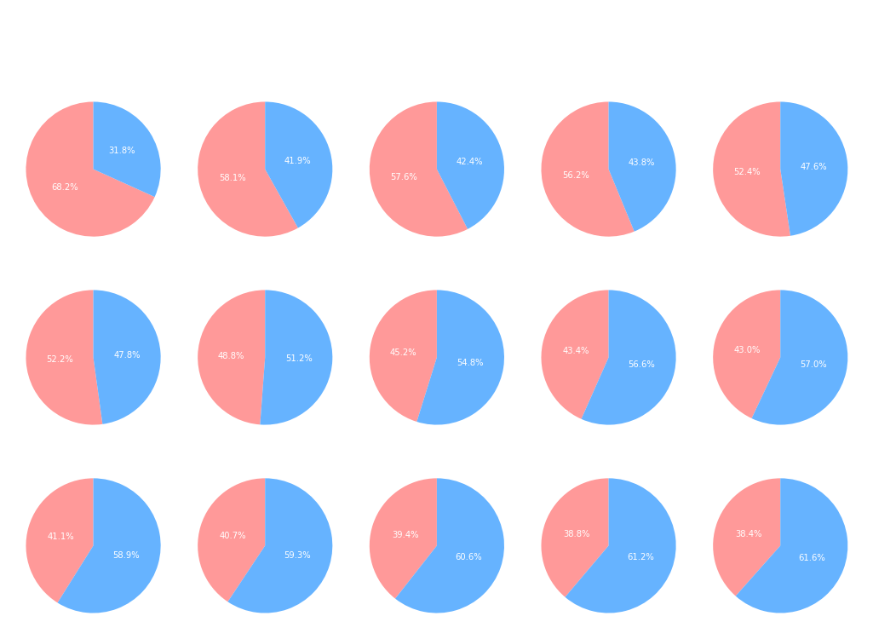
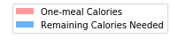
Calories Distribution
Breakfast - 20%
Lunch - 35%
Dinner - 35%
Snacks & others - 10%
All the fast-food restaurants, excess the Calories contents.
REF:https://globalnews.ca/news/3615212/this-is-what-your-breakfast-lunch-and-dinner-calories-actually-look-like/

Slide 14
Protein & Carbohydrate
Calories come from protein, carbs, sugar, and so on.
Within given Calories, comparing how much nutrition facts body needs and how much nutrition facts that one serving fast food contains.
For example: if one serving fast food offers 1000 Calories (50% of daily intakes), whether it will 50% of protein that daily needs.

Slide 15
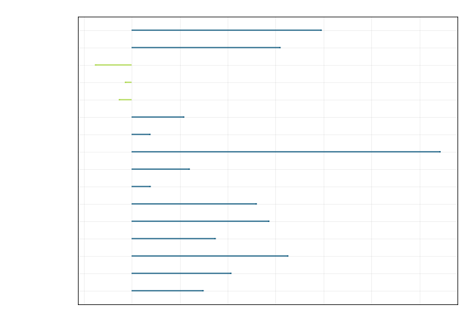
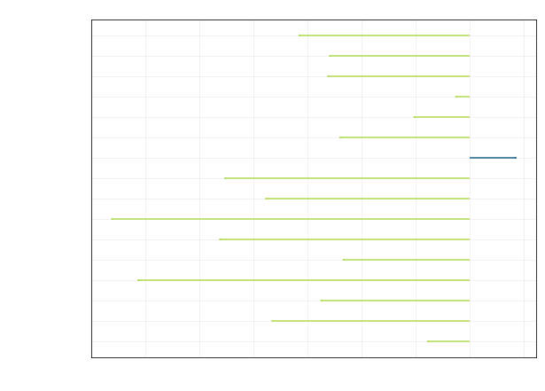
Fast food offers extreme unbalanced nutrition elements..
Blue - Nutritional content is enough for body demand
Red - Nutritional content is not enough
The line show the difference between how much recommended nutrition facts intake and how much protein contained per meal.

Slide 16
Sugar and Sodium
Sugar has no percent Daily Value.
DGA = Dietary Guidelines recommended limit
Recommended Sugar intakes is less than 10% *2000 / 4 = 50g
Sodium

Slide 17
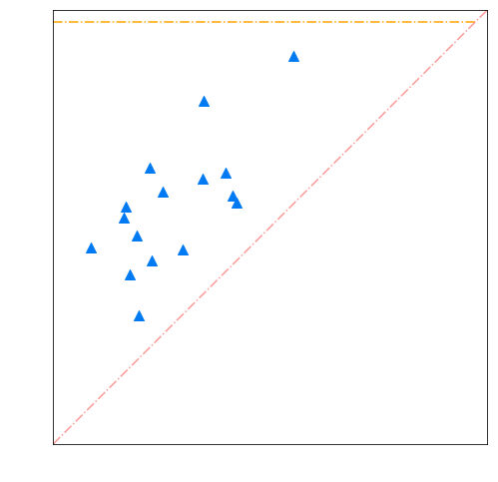
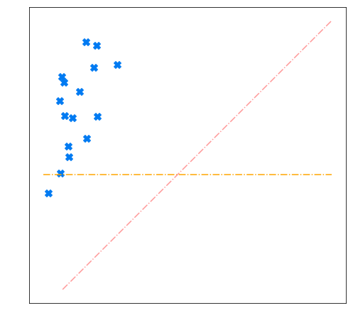
Sodium Sugar

Slide 18
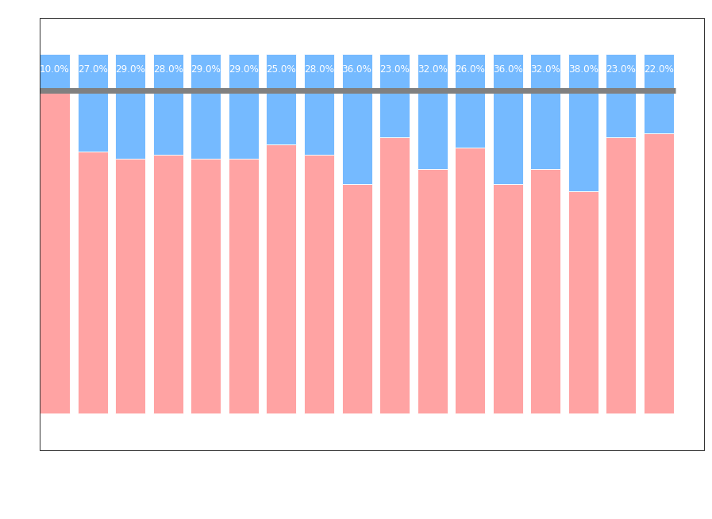
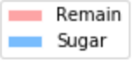
Each gram of sugar provides 4 calories
Recommended sugar intakes = 10% of calories
All the fast food restaurants meal has excess sugar content .

Slide 19
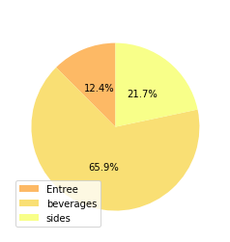
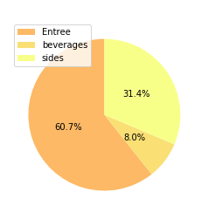
The highest sugar content is in beverages

Slide 20
Conclusion
In one serving fast food, Calories contents are too high.
The nutrient fact contents are imbalanced.
Comparing to daily recommended intakes limits, the content of sodium and sugar are excess body demand.
Overall we can conclude that the fast food is unhealthy

Slide 21
Determine correlations between fast food restaurant prevalence and certain symptoms
Model coverage and roadmap:
Simple linear regression (Total restaurants VS Symptoms stats)
Multiple linear regression (4 dimensions)
Multiple linear regression (3 dimensions)
K Means clustering
Simple linear regression (“Unhealthy” restaurants VS Symptoms stats)

Slide 22
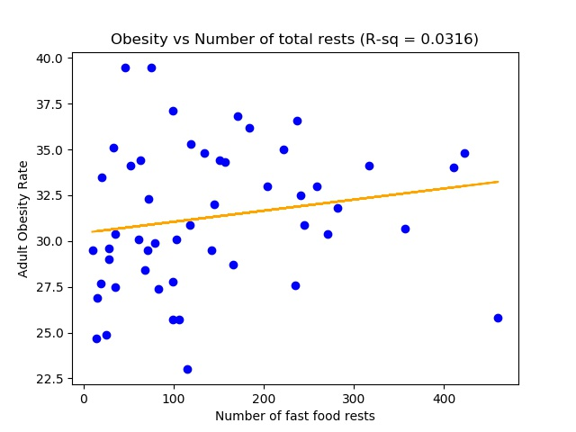
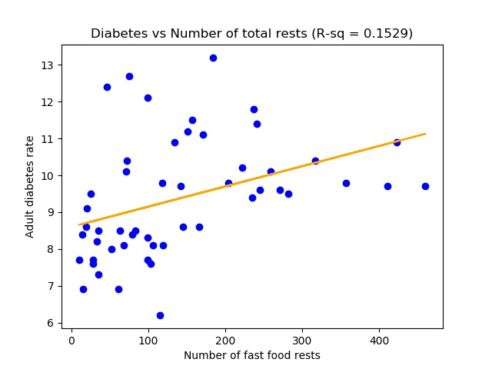
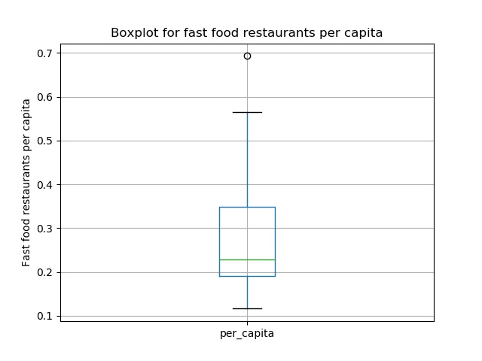
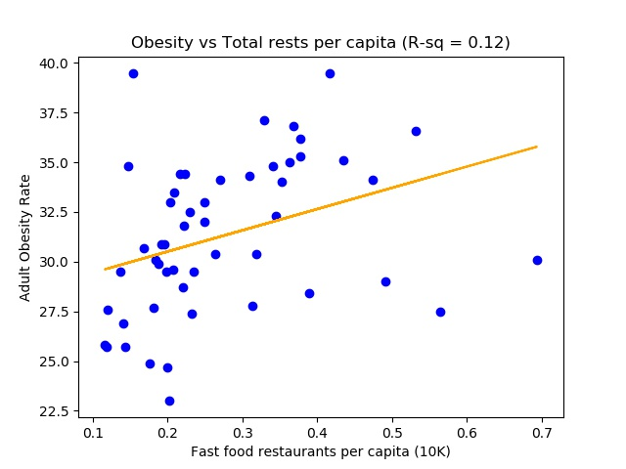
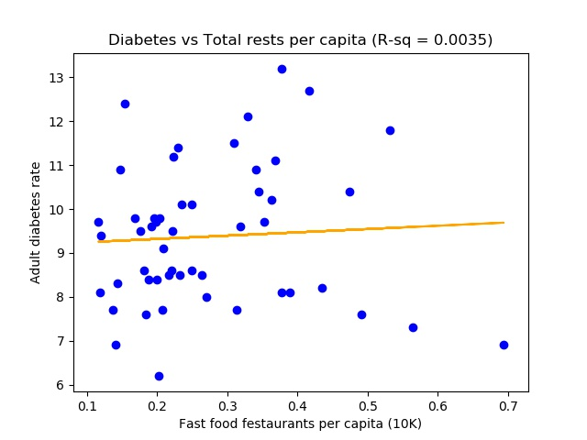
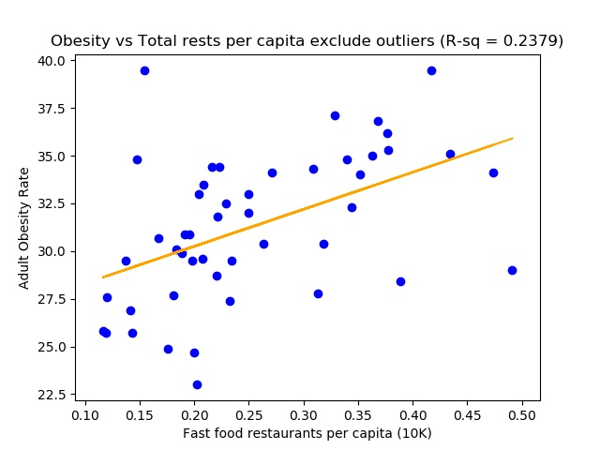
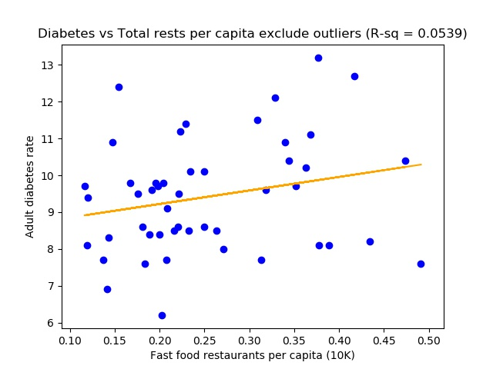
Simple linear regression (Total rests VS Symptoms)

Slide 23
K Means clustering
5 dimensions : Calories, Protein, Carbs, Sodium, Sugar
Difficult to create articulate visualizations
Difficult to interpret each cluster
Dimension reduction
Only use effective dimensions/columns
Multi-linear regression
Remaining columns: Protein, Carbs, Sugar

Slide 24
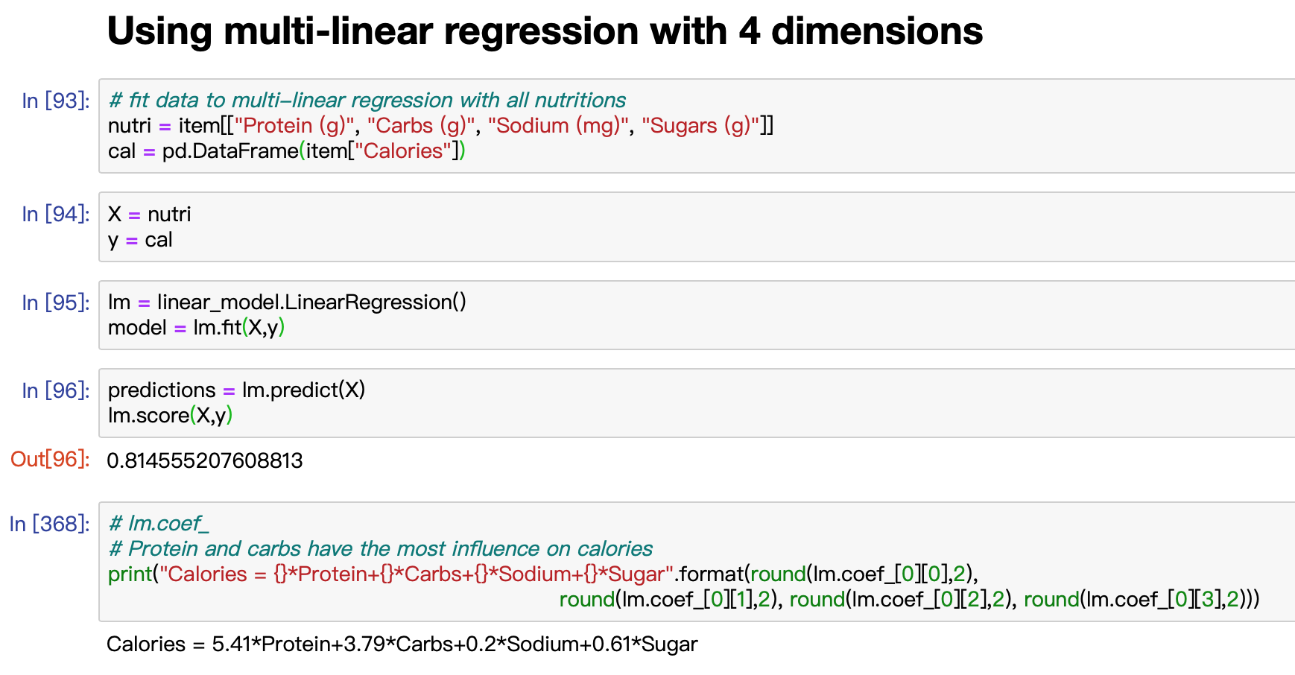
Multi-linear regression (4 dimensions)

Slide 25
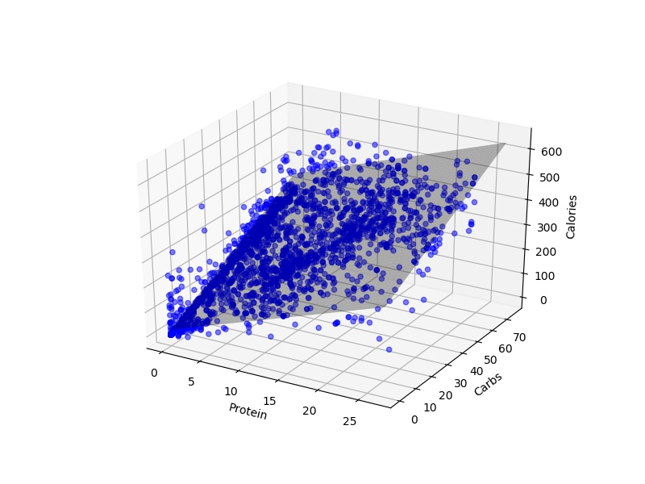
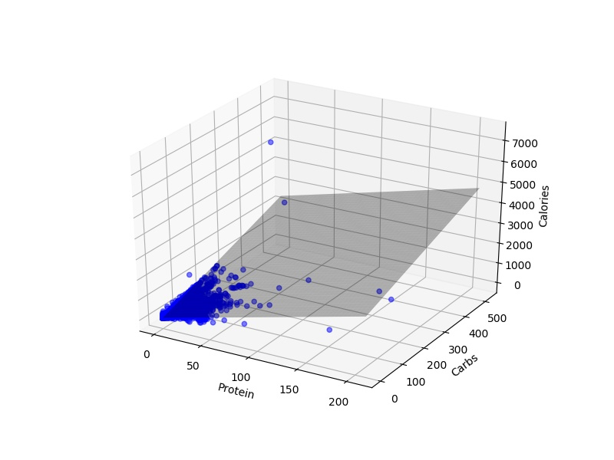
Multi-linear regression (3 dimensions)

Slide 26
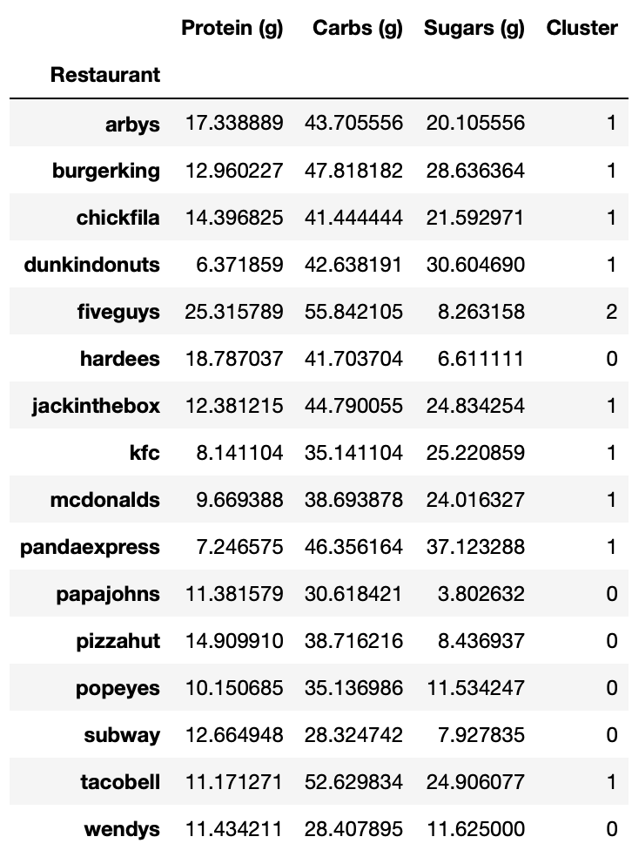
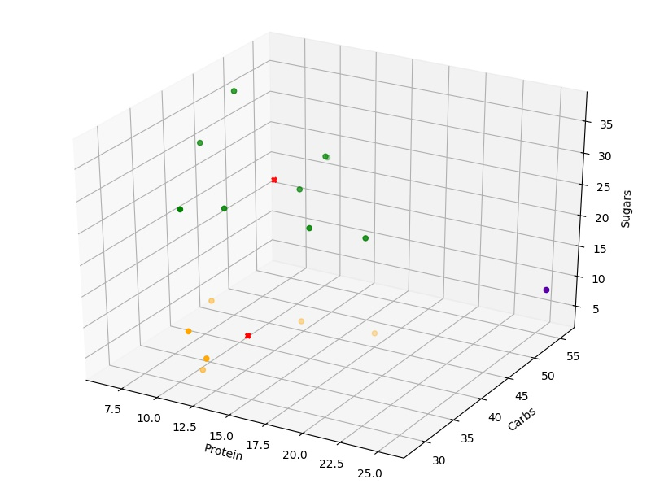
K Means clustering

Slide 27
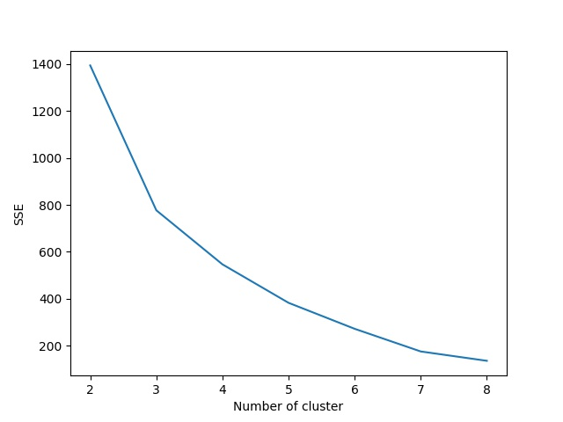
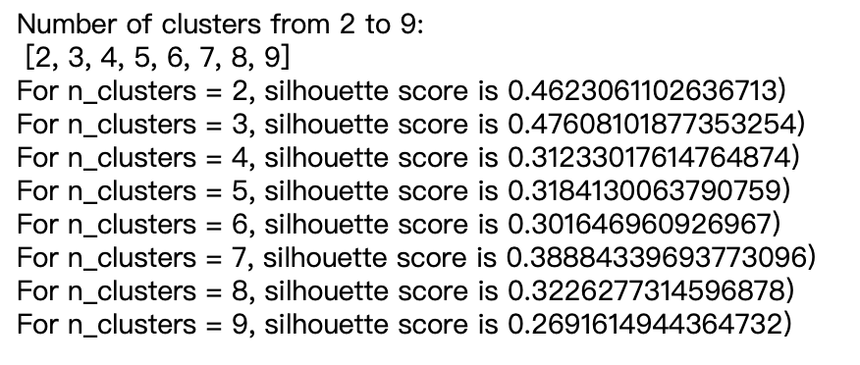
K Means clustering evaluation

Slide 28
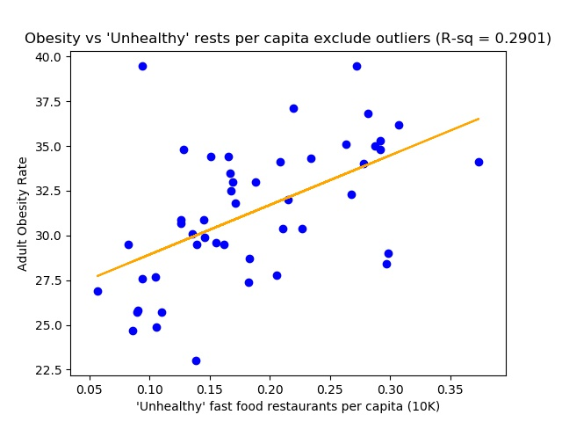
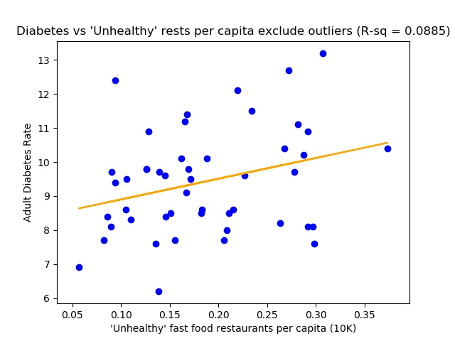
Simple linear regression (“Unhealthy rests)

Slide 29
Conclusion
Not all fast food restaurants are “unhealthy”
Only the ones with high on sugar and low on protein are clustered into “unhealthy” group
Some reflections:
More symptoms could be taken into account
More comprehensive nutrition facts could be collected
Always could perform a better data cleaning job

Slide 30
Application: Food recommendation system
Goal: Create a food recommendation system which allows audiences enter their location (city level) and recommend food based on their preferences
Data preprocessing:
All items dataset
Entrees
Beverages
Salads or sides
Notes:
Base on item description, I splitted the whole dataset into three and analyzed them seperately.

Slide 31
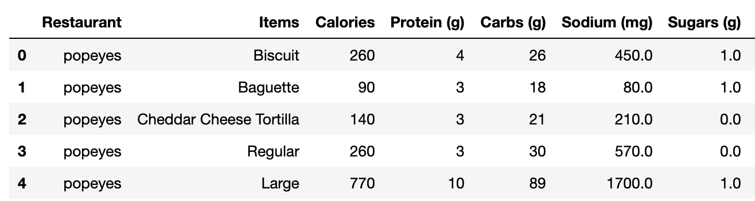
clustering using Scikit-Learn
Dataframe example
We have some troubles here:
Notes:
Five features
Hard to visualize
Calories has strong relations with Protein and Carbs, hence those feature may not be completely independent
besides, sodium columns in each seperate dataset all have high variance, this wu definitely affect the result of clustering.

Slide 32
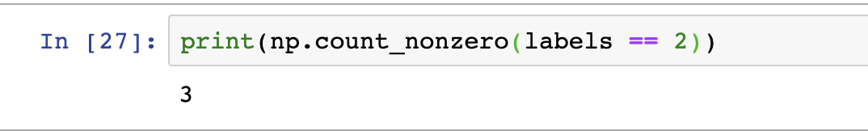
Potential bad results
Bad clustering result for entrees dataset
Notes:
After applied kmeans clustering on 5 d entree dataset, we find out just three items are labeled as 2, which is not cool since we have over 1000 entrees in our dataframe

Slide 33
Some modifications
Dimension Reduction
Keep independent features
Outliner cleaning
Delete points have unreasonable values

Slide 34
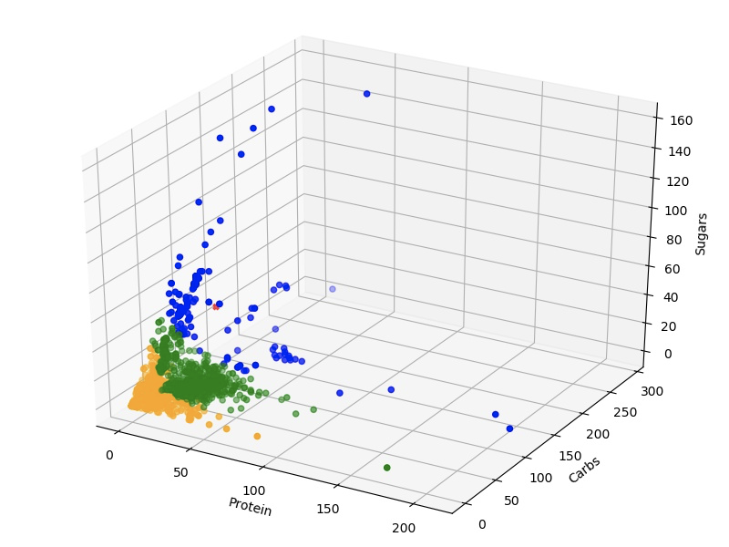
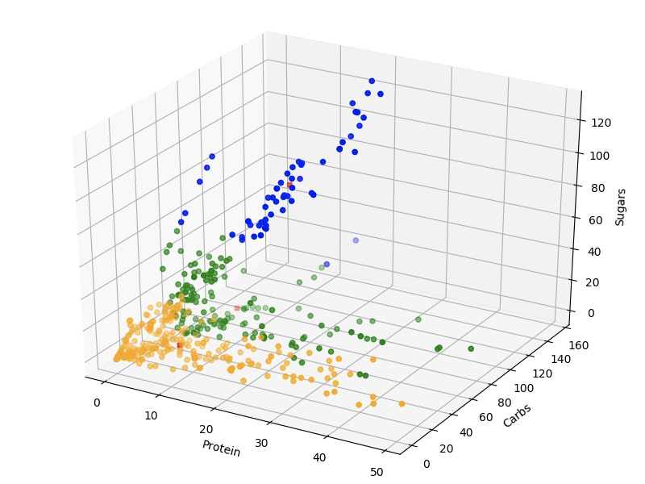
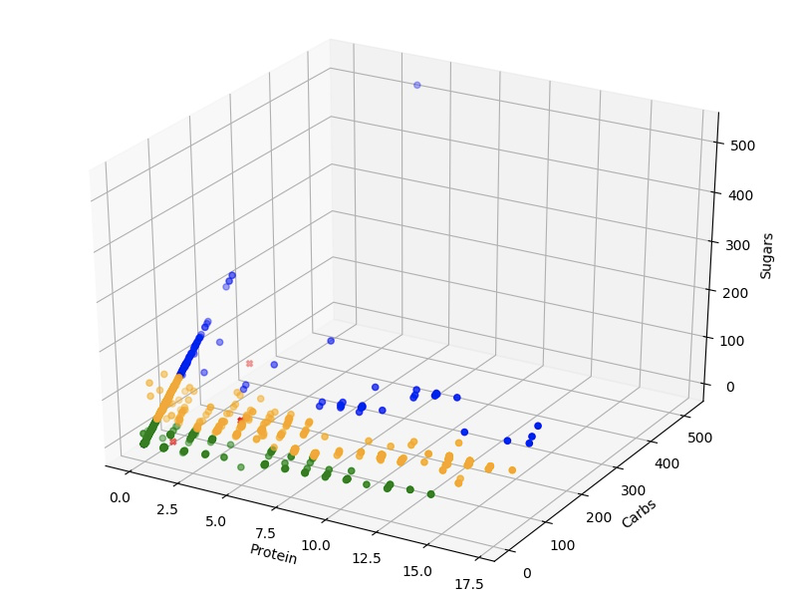
Clustering Graphs
Entrees
label 0 - Orange - Healthy
label 1 - Green - Medium
label 2 - Blue - Unhealthy
Beverages
label 0 - Orange - Medium
label 1 - Green - Healthy
label 2 - Blue - Unhealthy
Salads and Sides
label 0 - Orange - Healthy
label 1 - Green - Medium
label 2 - Blue - Unhealthy

Slide 35
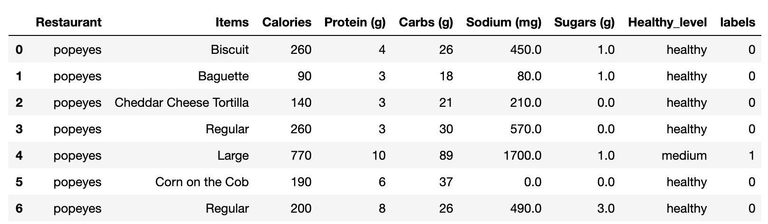
After clustering and labelling
Dataset example
Notes:
Now we have two more columns, one is the label from k-means clustering and the other is corresponding healthy_level

Slide 36
Logic behind our recommendation system
Users enter their cities and three preference
City in restaurant dataset?
Get restaurants in users’ city
Get foods satisfy users’ preferences from three datasets
No
Yes
Start over
Return results to audiences
Randomly select one dish from each qualified restaurant

Slide 37
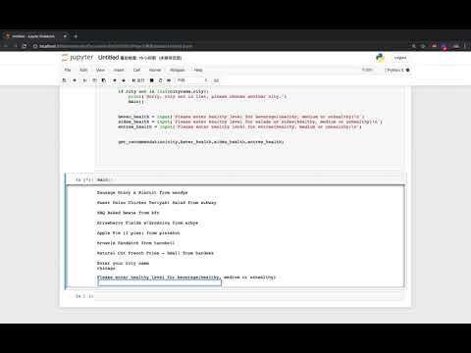
Food Recommendation System practice
Practice 1:
City: Washington
Entree: healthy; salads and sides: medium; beverage: unhealthy.
Practice 2:
City: Chicago
Entree: medium; salads and sides: unhealthy, beverage: healthy

Slide 38
Data sources
https://www.nutrition-charts.com/fast-food/
https://www.kaggle.com/datafiniti/fast-food-restaurants
https://gis.cdc.gov/grasp/diabetes/DiabetesAtlas.html#
https://www.cdc.gov/nccdphp/dnpao/data-trends-maps/index.html

Slide 39
Reference
“Fast Food Industry Analysis 2019-Cost and Trends”, Retrieved from franchisehelp.com. Franchise Help. 2018. p. 1.
https://health.gov/dietaryguidelines/2015/guidelines/appendix-7/
https://www.accessdata.fda.gov/scripts/InteractiveNutritionFactsLabel/factsheets/Total_Carbohydrate.pdf
https://www.accessdata.fda.gov/scripts/InteractiveNutritionFactsLabel/factsheets/Protein.pdf
“Fast Food Consumption Among Adults in the United States, 2013–2016 ” Retrieved from cdc.gov/nchs/data/
https://globalnews.ca/news/3615212/this-is-what-your-breakfast-lunch-and-dinner-calories-actually-look-like/

Slide 40

Any Question?

